Slide 1
We Are Glad You’re Here Parent Academy: Hill City Elementary

Slide 2
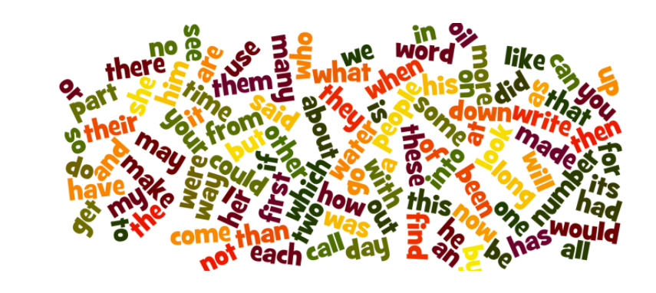
What are Sight Words and Why are They Important?
Word recognition is an important domain in successful reading. Being able to recognize words immediately allows a reader to focus his/her attention on the meaning of the text versus interrupting comprehension to figure out individual words. Ultimately, building reading FLUENCY!
FRY Words are the most commonly read words and are ranked in order of frequency.

Slide 3
Sight Word Apps
SPELL

Slide 4
Interactive Sight Word Games
http://www.sightwordsgame.com/sightwordgames/top-ten-sight-word-games/
http://www.thecurriculumcorner.com/thecurriculumcorner123/2014/04/28/flip-flop-fry-fry-word-games/
http://interactivesites.weebly.com/readingsight-words.html

